Slide 1


Photon and Neutron Open Science Cloud
A. Götz
on behalf of the PaNOSC consortium
22 November 2018
This project will receive funding from the European Union's Horizon 2020 research and innovation programme under grant agreement No 823852

Slide 2

Research data challenges
Recall: New science = a lot of data!
Hurdles for users of our RIs:
Quantity of data generated too big to transfer
Availability of adequate software can be problematic
Big data need big computing resources
New users: non-experts, need help in their data analysis
Long term storage of the data (regulations and requirements)
The PaNOSC partners operate large-scale RIs that are part of Europe’s big-data science factories.
They face common challenges, shared by many other RIs in Europe.
This project will receive funding from the European Union's Horizon 2020 research and innovation programme under grant agreement No 823852

Slide 3


PaNOSC Goals
Data Stewardship
Generalise the adoption of FAIR open data principles
EOSC
Federate data catalogs and integrate in EOSC and OpenAire meta-catalog, AAI, download services
Data Services
Develop new data analysis, modelling and simulation services
User Training
Train users how to write Data management plans, improve metadata, using DOIs, manage data better
This project will receive funding from the European Union's Horizon 2020 research and innovation programme under grant agreement No 823852

Slide 4








PaNOSC H2020 project
H2020 proposal to INFRAEOSC-4
Partners: ESRF, ILL, XFEL.EU, ESS, CERIC-ERIC, ELI, EGI
Description: cluster of ESFRI Photon and Neutron sources
Observers/non-funded: GÉANT, EUDAT, national RIs
Linked 3rd parties via EGI: DESY, STFC, CESNET Decision: Accepted on 13/8/2018
Status: Grant Agreement signed
Home page: https://panosc.eu
Budget: 12 M€
Coordinator: ESRF
Planned start date: 1/1/2019
Project duration: 4 years
Kick-off meeting
15-16 January at ESRF
Photon and Neutron Open Science Cloud
This project will receive funding from the European Union's Horizon 2020 research and innovation programme under grant agreement No 823852

Slide 5
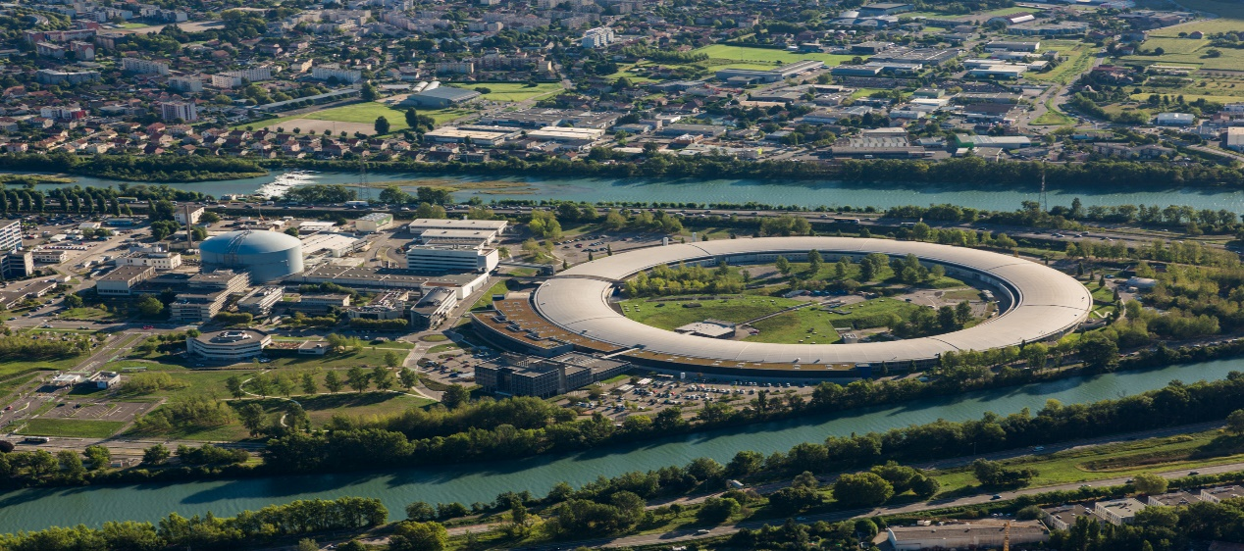
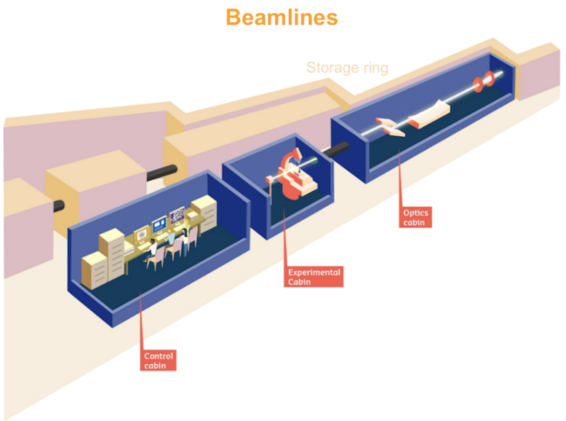
Who are the PaNOSC ESFRI Ris ?
 | ILL | ESRF | CERIC | XFEL | ELI | ESS
Operating since | 1972 | 1994 | 2014 | 2017 | 2018 | 2022
Users / yr | 1200 | 6000 | 500 | 850 | 100 | 100
Beamlines | 40+ | 40+ | 40+ | 5 | 20+ | 20+
Beamline experimental station
ESRF + ILL (Grenoble, France)
This project will receive funding from the European Union's Horizon 2020 research and innovation programme under grant agreement No 823852

Slide 6
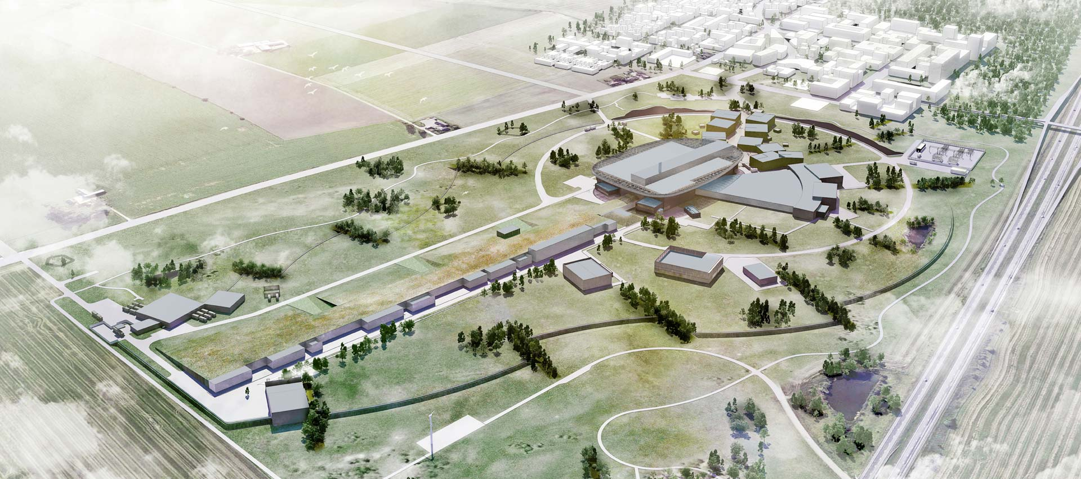
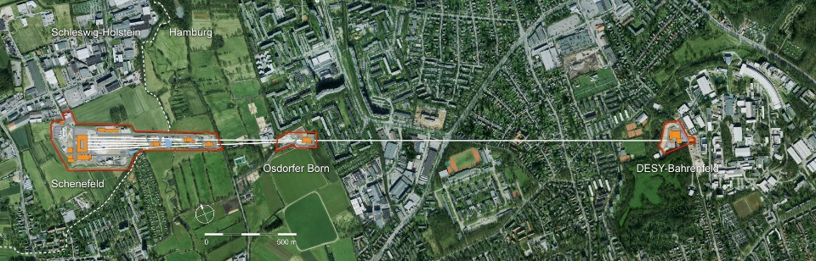
Who are the PaNOSC ESFRI Ris ?
 | ILL | ESRF | CERIC | XFEL | ELI | ESS
Operating since | 1972 | 1994 | 2014 | 2017 | 2018 | 2022
Users / yr | 1200 | 6000 | 500 | 850 | ? | 100
Beamlines | 40+ | 40+ | 40+ | 5 | 20+ | 20+
ESS (Lund, Sweden)
XFEL (Hamburg, Germany)
This project will receive funding from the European Union's Horizon 2020 research and innovation programme under grant agreement No 823852

Slide 7
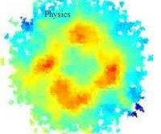

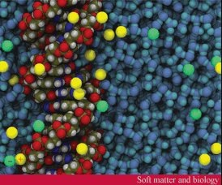
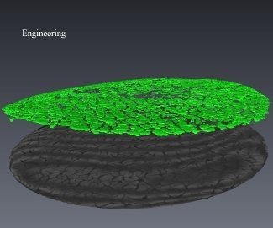
Broad time and length scales
ANGSTROMS AND PICOSECONDS
electronic and magnetic structure
strongly correlated electron systems
PHYSICS
NANOMETRES AND NANOSECONDS
chemical structure and dynamics
structure/property relationships
CHEMISTRY
MICRONS AND MICROSECONDS
interfaces, micelles, etc.
protein structure and dynamics
SOFT MATTER & BIOLOGY
METRES AND MONTHS
engineering measurements, heritage science
Imaging, tomography, strain & stress, etc.
eNGINEEring & MATERIALs SCIENCE
7
This project will receive funding from the European Union's Horizon 2020 research and innovation programme under grant agreement No 823852

Slide 8
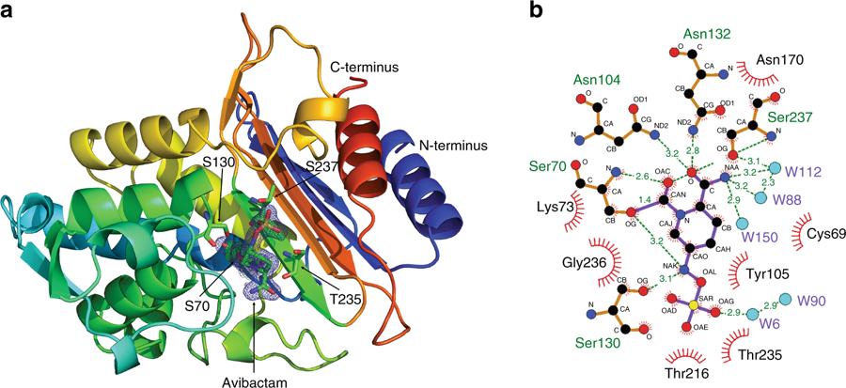
XFEL first results
Shining a light on antibiotic resistance uses serial
crystallography to solves 3D structure of enzyme CTX-M-14
This project will receive funding from the European Union's Horizon 2020 research and innovation programme under grant agreement No 823852

Slide 9


Before PaNOSC - 2018
 | ILL | ESRF | CERIC | XFEL | ELI | ESS
Data / yr | 200 TB | 8 PB | 1 PB | 3PB | ? | 0
Data Policy | 2011 | 2016 | 2014 (3/8) | 2017 | ? | 2017
Metadata catalogue | Local | Icat | Local | myMdC | ? | SciCat
Metadata definitions | Nexus | Nexus | custom | myMdC | ? | Nexus
DOI | 2012 | 2018 | No | 2018 | ? | 2018
Open Data | yes | yes | No | yes | no | yes
Data Services | pilot | in progress | remote ops | in progress | ? | in progress
Common data API | No | No | No | No | No | No
User training | No | No | No | No | No | No

Slide 10
After PaNOSC - 2023
 | ILL | ESRF | CERIC | XFEL | ELI | ESS
Data / yr | 600 TB | 50 PB | 15 PB | 100PB | 10 PB | <1PB
Data Policy | 2011 | 2016 | 2019 | 2017 | 2019 | 2017
Metadata catalogue | Local | Icat | Icat | myMdC | [Icat] | SciCat
Metadata | Nexus | Nexus | Nexus | Nexus | [Nexus] | Nexus
DOI | Yes | Yes | Yes | Yes | Yes | Yes
Open Data | Yes | Yes | Yes | Yes | Yes | Yes
Common data API | Yes | Yes | Yes | Yes | Yes | Yes
User training | Yes | Yes | Yes | Yes | Yes | Yes
Data Services | Prod | Prod | Prod | Prod | Prod | Prod
EOSC | Integrated | Integrated | Integrated | Integrated | Integrated | Integrated

Slide 11
Some challenges for RIs and EOSC
FAIR data – more difficult to implement than most believe
Implementing an electronic logbook as part of the RICH metadata capture
Promote use of Jupyter notebooks and workflows to capture data analysis
Integration - services linked by a supported federated identity scheme covering more of the research life cycle where users access data, software, IT capacity and the expertise for performing analysis
GEANT will help PaNOSC by hosting AAI, ESFRIs to provide expertise
Hybrid model - should not compete with but rather profit from ease of use and rates of innovation of commercial service providers
PaNOSC will procure and integrate commercial services
Provenance, citation and use of data & software
How to get users to cite DOIs and provide Open Data
Business model of how to provide services to all scientists and general public
ESFRI Photon and Neutron RIs have funding for Users who come to the source, they do not have funding for providing services for Open Data
This project will receive funding from the European Union's Horizon 2020 research and innovation programme under grant agreement No 823852

Slide 12

Conclusion
PaNOSC is a joint effort to help the ESFRI Photon and Neutron sources to
adopt and implement data management, simulation and analysis services
for dealing with the increasing data rates and volumes and making
Open Data available to the EOSC
Open Data & Open Science
builds on
Data Management, Simulation
& Analysis Services
This project will receive funding from the European Union's Horizon 2020 research and innovation programme under grant agreement No 823852

